Slide 1
PDP(PRODUCT DESIGN) FLUORINE BREAKER
B2-42
MANOJ-EDM18B033
KIRAN-EDM18B032
LOKESH-EDM18B031
SAI KUMAR-ESD18I007

Slide 2
INTRODUCTION Fluoride is one of the very few chemicals that have been shown to cause significant effects in people through drinking water. Fluoride has beneficial effects on teeth at low concentrations in drinking water, but excessive exposure to fluoride in drinking water, or in combination with exposure to fluoride from other sources, can give rise to a number of adverse effects.A 1994 World Health Organization expert committee suggested a level of fluoride from 0.5 to 1.0 mg/L PROBLEM STATEMENT
To find the amount of fluorine content present in the drinking water and to ensure that the content is in the permissible limits and safe to drink.
PRODUCT DESCRIPTION:
The FLUORINE BREAKER (Handheld Colorimeter) provides a simple, accurate and cost-effective way to measure fluoride.

Slide 3
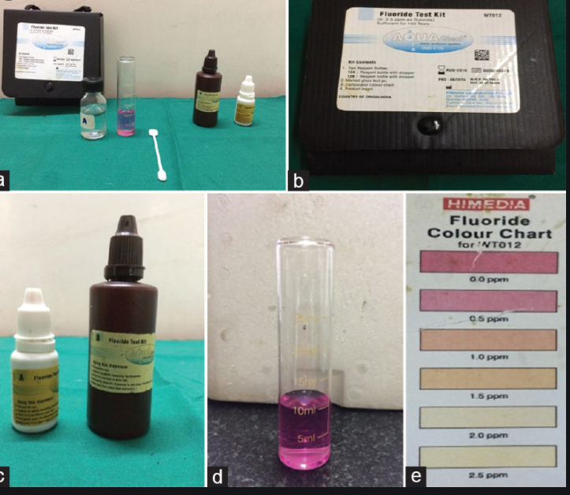
MOST VIABLE PRODUCT
Our product bridges the gap between simple chemical test kits and professional instrumentation. Chemical test kits have limited accuracy and resolution since they rely upon the human eye to discern differences in color..Our Productuses a fixed wavelength LED and silicon photo detector to provide the accuracy of professional instrumentation at the affordable price of a chemical test kit.
Compact, Portable Design
One-Button Operation
Easier to use and more accurate than chemical test kits
Small size, big convenience
Ideal for: Drinking Water, Environmental, Industrial
NOVELITY IN OUR PRODUCT:
Though there are many methods available for the estimation of fluorine, our aim is to develop
an inexpensive and portable device , which can be used to estimate fluoride at field level .
The conventional methods for fluoride estimation require sophisticated instruments , and
hence are expensive and not portable. Apart from this , if we want the device to work at
field level , it should be small in size.
Hence, our aim is to develop a simple colorimeter which gives fairly accurate results.

Slide 4
WORKING PRINCIPLE OF THE DEVICE:
The device is a low cost colorimeter, which detects the change in the fluoride concentration of a solution depending upon the change in colour of the solution. The method is based on the principle of colorimetry.
When light falls on a coloured system, a part of the light will be absorbed and reflected by it and rest is transmitted. We choose a coloured chemical system whose colour changes when water containing fluoride comes in contact with it.
The itensity of the transmitted light depends on colour of the solution and hence the amount of fluorine present in the solution. The intensity can be measured using a detector and can be correlated with concentration of fluorine ions in the solution.
When the intensity of the transmitted light changes, the signal from the detector changes accordingly, and this in turn changes the output voltage. This change in voltage is measured and is correlated with concentration of fluorine.

Slide 5
DESIGN OF THE PROTOTYPE
THE FLUORIDE CONTAINING SOLUTION IS PLACED IN BETWEEN THE LED AND PHOTOTRANSISTOR.LIGHT FROM THE LED PASSES THROUGH THE SOLUTION AND FALLS ON THE PHOTOTRANSISTOR WHICH GENERATES A VOLTAGE ACROSS ITS TERMINALS.
THE OUTPUT VOLTAGE OF THE PHOTOTRANSISTOR IS QUITE SMALL IN MAGNITUDE AND HENCE IS AMPLIFIED BY AN NON INVERTING AMPLIFIER.
THE OUTPUT IS TAKEN ACROSS OPERATIONAL AMPLIFIER AND A REFERENCE GROUND AS THE OP-AMP IS BEING OPERATED BY A SINGLE POWER SUPPLY A REFERENCE GROUND IS CREATED ABOVE THE GROUND.
THE REFERENCE IS GENERATED THE ZENER DIODE CONNECTED TO A BATTERY. CAPACITIVE COUPLING IS ESSENTIAL TO PREVENT THE OUTPUT AND INPUT VOLTAGES TO EQUAL THE REFERENCE VALUE.
Notes:
YB

Slide 6
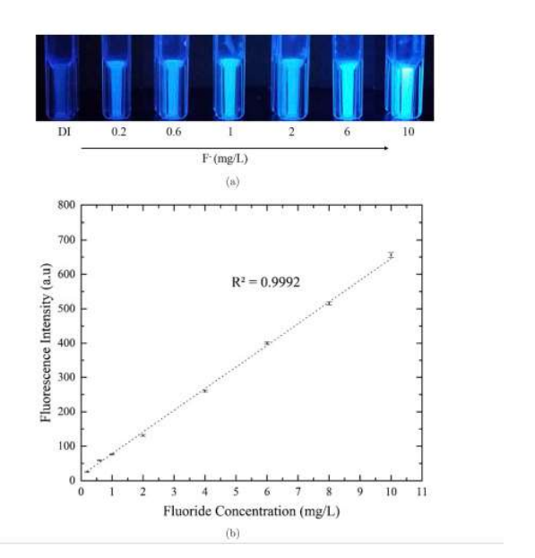
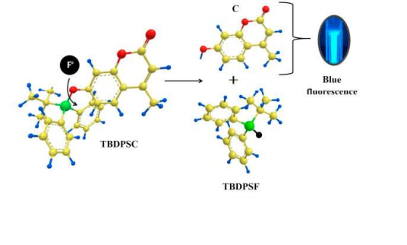

Slide 7
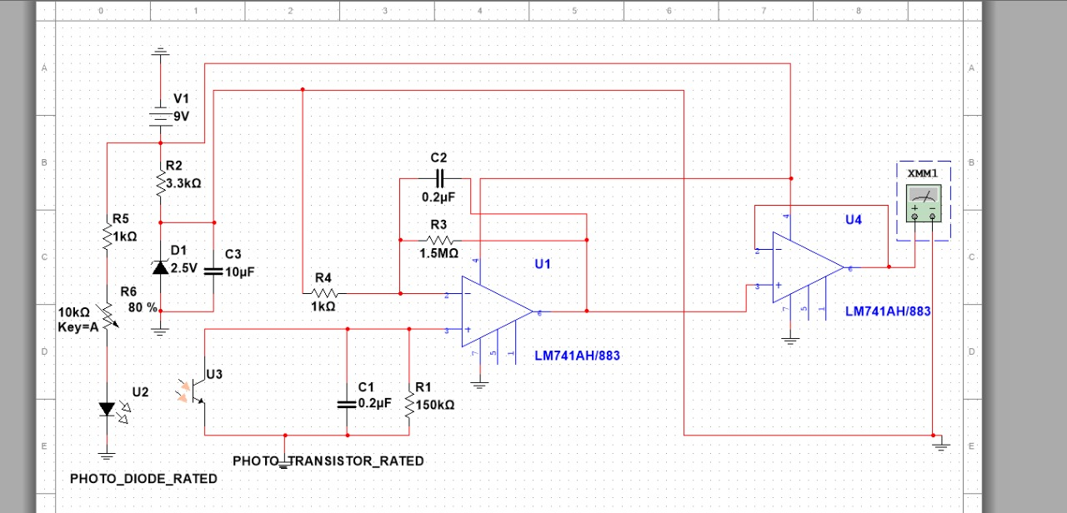
CIRCUIT DESIGN

Slide 8
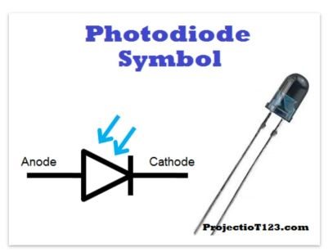
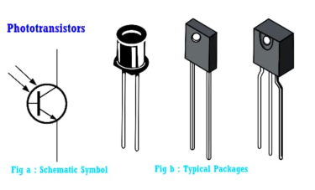
COMPONENTS

Slide 9
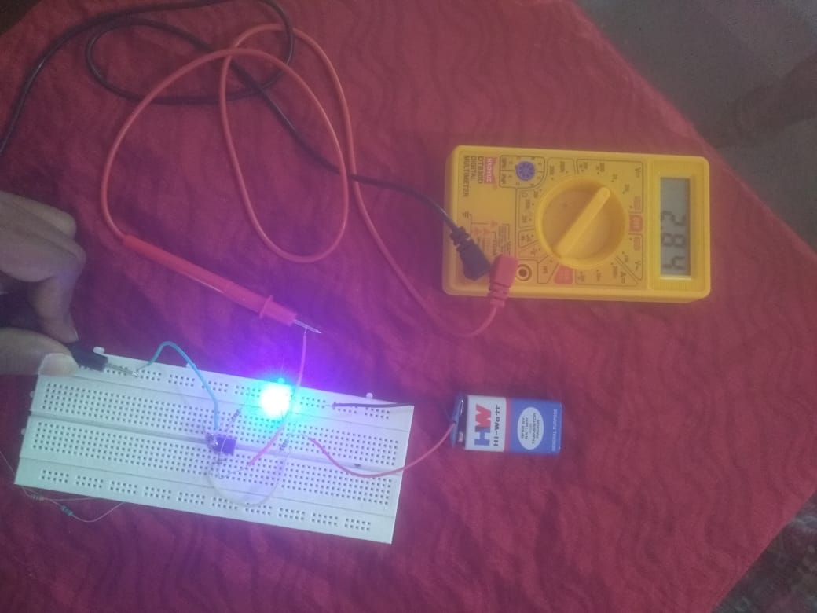
HARDWARE CIRCUIT

Slide 10


